Slide 1
CELEBRATE!
YOUR CAREER IN AGING
March 26 - April 1, 2023
CareersInAging.com | #CareersInAging

Slide 2
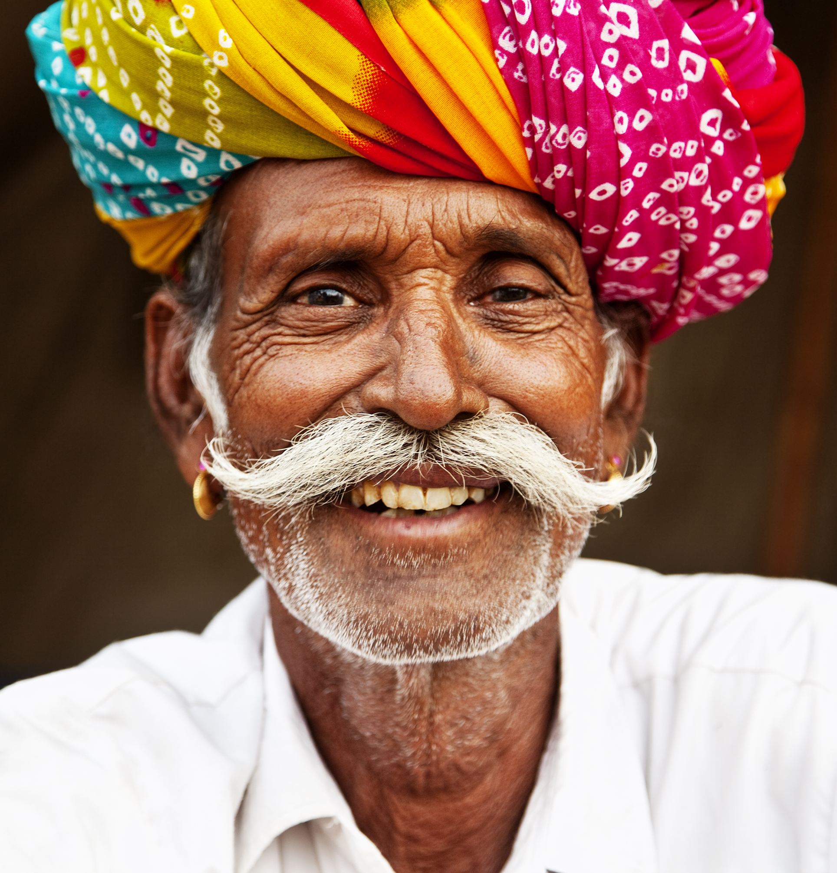
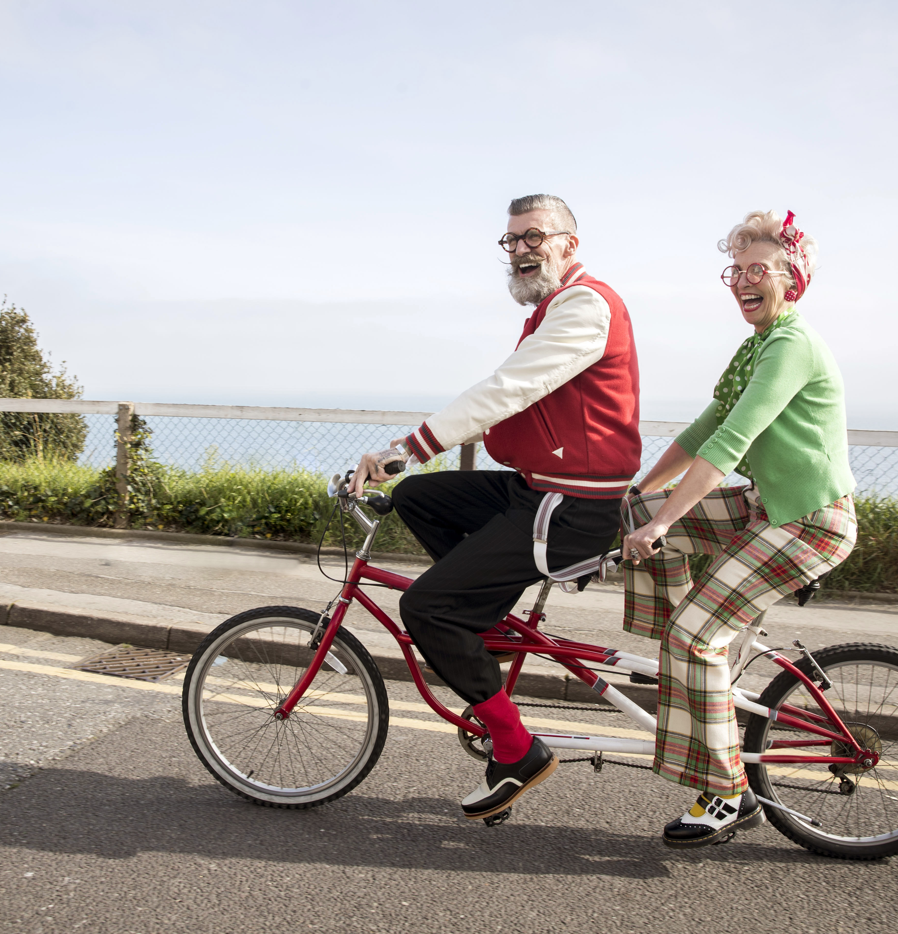


What is Aging?
Who is Aging?
Notes:
Suggested questions for warming-up: What brings you to this presentation? What do you hope to learn about the field of aging? What do you look forward to as you grow older? What questions and concerns do you have about growing older?
Aging isn’t something only happening to older people, we are all aging and growing older!
Aging is a multi-faceted process: biophysical, social, and psychological
Aging is shaped by the physical, societal, cultural, and environmental contexts in which we live
Aging is a universal human experience that unfolds at the individual level; we become less alike, rather than more alike, the older we grow
As we grow older, we change in many ways; aging is a combination of gains, losses, and continuities.
From Reframing Aging: “Aging is a dynamic process that leads to new abilities and knowledge we can share with our communities.” (https://www.reframingaging.org/)

Slide 3
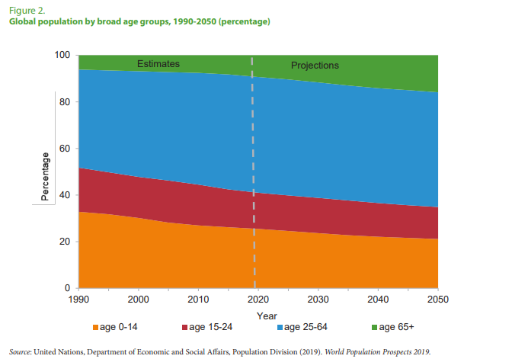
Why do Careers in the Field of Aging Matter?
Notes:
Careers in the field of aging matter in the 21st Century because the percentage of older people in the US will increase from about 15% to close to 25% by 2060.
Currently, the Baby Boomer age-cohort (people born 1946-1964) is 70.68 million; members of this generation are entering or are already experiencing later life. The Millennial age-cohort (born 1981-1996) is even larger, at 72.26 million in 2020.
Population aging isn’t only happening in the U.S. but is happening globally.
The number of jobs in the field of aging will increase, as will the need for a well educated and trained workforce who can meet the opportunities and challenges of an aging society.
A career in the field of aging can provide meaningful work, job security, and opportunities to serve in different roles throughout one’s career.
TIP: You may want to add a slide here that presents demographics from your own state or local area.

Slide 4
What is the Field of Aging?
  The field of aging is a broad and diverse landscape of practice where ever-expanding knowledge about aging is applied in the service of supporting older adults and their families, as well as addressing the challenges and opportunities of population aging at the societal (and global) level.
Notes:
The field of aging includes (but is not limited to!) careers that are intentionally focused on working with aging adults and founded on a gerontological perspective, such as long-term care supports and services, healthcare and end-of-life care, gerontological social work, aging advocacy and policy, community-based lifelong learning and recreation programs, and many other areas of application.
There are an increasing number of non-gerontological career areas -- such as in interior design, transportation, fitness, travel, and hospitality – which consider older people as a potential "niche" to whom to market and deliver specialized services.
Geriatrics is also part of the Field of Aging landscape. Geriatrics focuses on: The study of health and disease in later life; and the comprehensive health care of older persons and the well-being of their informal caregiver.

Slide 5
What is Gerontology?
Multi-disciplinary area of study, research, and applied practice.
Dedicated to improving overall well-being, quality of life, and the aging experiences of older people.
Focused on the needs of older people and the older population from an integrated biopsychosocial perspective.
Person-centered to ensure that all aspects of an older person’s culture and lifestyle are respected.
Aware of how the social determinates of health across the lifespan impact the aging process.
Notes:
Gerontology is commonly defined as the scientific study of aging, old age, and later life. The term “gerontology” is attributed to Metchnikoff, who first started using it in 1903. (Interestingly, it was a few years later when Nascher offered the term “geriatrics” to designate the medical specialty concerned with aging issues.)
However, this definition of gerontology, while pithy and straightforward, belies the complexity of the field. Here are a few of the kinds of descriptions you might come across:
Gerontology is the scientific study of aging, old age and later life.
Gerontology is an area of healthcare (distinct from geriatrics) that focuses on the needs of older persons.
Gerontology is a multidisciplinary field that includes perspectives on aging borrowed from other disciplines and professions, such as biology, psychology, sociology, epidemiology, public policy, nursing and social work.
Gerontology is an interdisciplinary enterprise involving the integration of research, theory, and practice from across multiple disciplines.
Gerontology is only in part a scientific endeavor; gerontology also includes perspectives from the arts and humanities in order to more deeply understand the lived experience of aging and old age.
While human beings – and all living organisms – begin aging from the moment they come into existence, and while Gerontology acknowledges aging as a life-course experience, Gerontology focuses primarily on the issues of adult aging and later life.
The biopsychosocial perspective enables gerontologists to prevent or mitigate the cascade of effects that can occur when an older person experiences a major change or loss in one area of their life.
Person-centered factors include sex, gender, and marital status, race, and ethnicity, ableness, isolation, socioeconomic status, and cultural factors including religion, spirituality, geographic origins, first language, etc.
The social determinants of health include income, housing and where people live, access to education, nutritious food, transportation, and health care, and employment opportunities and job choices.

Slide 6
What is a Gerontologist (and who can be one)?
As defined by the Academy for Gerontology in Higher Education (AGHE):
  “Gerontologists improve the quality of life and promote the well-being of persons as they age within their families, communities and societies through research, education and application of interdisciplinary knowledge of the aging process and aging populations.”
Notes:
As with any profession, psychology, sociology, social work etc., a person needs advance education and training in order to qualify as a Gerontologist.
To qualify as a “Gerontology Professional,” an undergraduate certificate, Associate or Bachelor’s degree in gerontology, aging studies, or related field is required.
To qualify as a “Gerontologist,” a graduate degree at the Master’s or doctorate level in gerontology, aging studies, or related field is required.

Slide 7
Gerontology vs. Geriatrics
Geriatrics focuses on:
  The study of health and disease in later life
  The comprehensive health care of older persons and the well-being of their informal caregiver
Notes:
Geriatrics is also part of the Field of Aging landscape. Although people often confuse gerontology and geriatrics, it is important to recognize that geriatrics is a specialty within the broader field of aging. Just like pediatrics focuses on healthcare in babies and children, geriatrics focuses on health and disease in later life; and the comprehensive health care of older persons.
Geriatric professionals e.g., physicians (geriatricians) and geriatric nurses who have a credential or experience confirming they are qualified to specialize with older people.
Geriatric specialists e.g., clinical psychologists, clinical social workers, and therapists who have specialized their practices to focus on older people.

Slide 8
Where are jobs in the Field of Aging?
Federal, state, and local governmental agencies
Manufacturers and businesses
Entrepreneurial ventures
Community-based supports and services
Residential facilities
Nursing care facilities
Not for profit organizations
Academic, educational, and research settings
Other areas?
Notes:
Federal, state, and local governmental agencies.
Manufacturers and businesses that produce, market, and sell product designed specifically for the wants and needs of older people.
Entrepreneurial ventures that provide programs and services to older people.
Communities designed to meet the wants and needs older people living on their own.
Residential facilities that provide older residents with assistance that enables them to live as independently as possible, safely.
Nursing care facilities that provide medical care and assisted living facilities for older people who need a little support to live alone safely.
Not for profit organizations that provide community, human service, religious, and professional development for professional in the field of aging.
Academic, educational, and research settings.
Why pursue these opportunities?
Broad career opportunities
Stimulating and challenging field
Opportunities to collaborate across disciplines
Potential to make a difference in society and in the lives of others
Gerontology Professionals work both directly and indirectly with older people.

Slide 9
Gerontology Professionals Working Directly with Older People
Developing and running programs
Planning and facilitating activities
Advocating with and on behalf of older individuals
Providing case and care management services
Providing direct care
Notes:
Developing and running programs for older people such as health promotion, life-long learning, or intergenerational programs.
Planning and facilitating activities for older people at adult community centers, community agencies, or retirement communities.
Advocating with and on behalf of older individuals residing independently and older residents and patients in a variety of settings.
Providing case and care management services to older clients and their families:
Counseling about caregiving, employment, death and dying, or mental health.
Advising about estate planning, investments, and housing options such as independent living, assisted living, and skilled nursing care facilities.
Providing direct care to older persons in hospitals, clinics, nursing homes, or through adult day care or home care programs, with an appropriate credential or license.
Note: There are state-level regulations governing credentialing and licensure for some of these career areas.

Slide 10
Gerontology Professionals Working Indirectly with Older People
Conducting needs assessments
Planning and administering programs and services
Teaching courses about aging
Advocating for policy change
Designing products
Advising businesses and other entities
Researching aging issues
Notes:
Conducting needs assessments to evaluate community-based programs and service delivery systems.
Planning and administering community-based programs and services.
Teaching courses about aging to high school, college, and university students, health care professionals, and older people.
Advocating for policy change on behalf of aging issues and the older population before governmental bodies or in institutional settings.
Designing products to meet the special interests and needs of older persons.
Advising business, industry, and labor regarding older workers and consumers.
Research and analysis of issues related to aging and later life.

Slide 11
Educational Pathways in Gerontology
Community Colleges
  Associate of Art/Science (occupational and/or transfer degrees)
  Undergraduate and Continuing Education Certificates
Four-Year Colleges and Universities
  Bachelor of Art/Science (majors and/or minors)
  Certificates
University Graduate Schools
  Master of Art/Science
  Doctorate (PhD)
  Graduate Certificates
To search for current Gerontology programs, go to: https://www.aghedirectory.org/
Notes:
Community College Degrees prepare students to transfer to a university to complete a BA or BS in a related discipline or gerontology; career pathway degrees can prepare you to transfer and/or lead directly to employment in the field of aging
Master's-level training prepares professionals to become skilled administrators, planners, and practitioners; many universities offer graduate specializations which permit students to major in another academic or clinical field (e.g., social work) with a specialization in aging
Doctoral programs prepare students for careers in research, teaching, administration, or clinical practice; Doctoral programs can be in Gerontology, or can be a doctoral-level specialization in aging within other academic (e.g., sociology) and clinical departments
Certificates are offered at the undergraduate, graduate, and continuing education level. Certificates are shorter-term, require fewer credits than a degree, and provide either a foundation in Gerontology or a specialized focus, such as on dementia care, long-term care support and services, etc. These can be added to other degrees to allow professionals to fill a niche in their particular field.

Slide 12
Tips for Starting Your Career in the Field of Aging
Identify your areas of interest and core values
Seek out volunteering, field placement, and internship opportunities
Participate in gerontology and aging-related coursework and continuing education workshops
Join professional organizations and student groups
Familiarize yourself with local, state, and national organizations, agencies and programs
Track job listings in gerontology and across the field of aging
NETWORK!!!
Notes:
Gerontological Society of America’s Emerging Scholar and Professional Organization (ESPO) provides students with opportunities to be actively involved in the field of gerontology. ESPO members enjoy full Society membership benefits and privileges at significant discounts. When you become a student or transitional member of GSA, you automatically become an ESPO member: https://www.geron.org/member-groups/emerging-scholar-and-professional-organization
Does your college or university have a gerontology or field of aging student group and/or affiliation with Sigma Phi Omega, the gerontology honor society? https://sigmaphiomega.org/

Slide 13
Organizations in Gerontology and the Field of Aging
American Society on Aging (ASA)
Academy for Gerontology in Higher Education (AGHE)
Gerontological Society of America (GSA)
National Association of Area Agencies on Aging (NAAAA)
National Association of States United for Aging and Disabilities (NASUAD)
National Council on Aging (NCOA)
National Institute on Aging (NIA)
US Administration on Aging (AoA)
United Nations (UN)
International Federation on Aging (IFA)
Notes:
Your state or local area might have professional organizations in gerontology and the field of aging that you can highlight here.

Slide 14
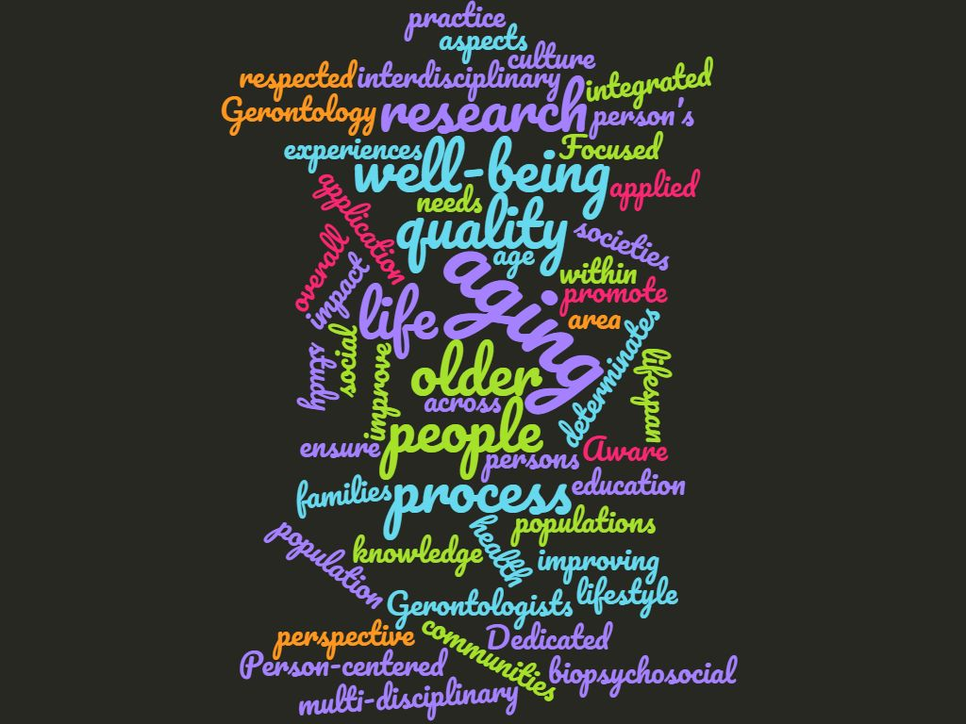
Discussion & Questions
Notes:
Some discussion prompts:
What are your current interests in terms of your education? Your future career?
What impact do you hope to have through your career?
In what ways might gerontology be relevant to your career?
What else would you like to learn about careers in the field of aging?

Slide 15
Thank you for your interest in Careers in Aging!
For more information, please contact:
(NOTE: This can be customized to include the presenter’s contact information or program information)

